Slide 1



Exhaustive Analysis on Indian Agriculture Sector

Slide 2

Learning Objectives
Understand the key trends and insights in the Indian agriculture sector.
Learn how to use Power BI for data visualization and in-depth analysis.
Analyze various datasets related to agricultural productivity, crop patterns, and economic impact.
Identify challenges in the agriculture sector and explore potential data-driven solutions.
GOAL
Source :

Slide 3
Tools and Technology used
Power BI: Used for data visualization and dashboard creation.
SQL: For querying and managing large datasets.
Excel: Data pre-processing and initial analysis.
Government/Private Datasets: Source of agricultural data for analysis.

Slide 4
Methodology
Data Collection: Gathering data from government sources, research institutions, and agricultural reports.
Data Cleaning & Preparation: Removing inconsistencies, handling missing values, and structuring the data.
Data Modeling: Creating relationships between different tables for meaningful analysis.
Visualization & Analysis: Using Power BI dashboards to generate insights.
Deriving Insights: Identifying key patterns, trends, and areas for improvement in Indian agriculture.

Slide 5
Problem Statement:
The Indian agriculture sector faces multiple challenges, including low productivity, inefficient resource use, and unpredictable weather conditions.
Lack of real-time data-driven insights results in poor decision-making among farmers and policymakers.
The need for an advanced analytical approach to optimize yield and profitability.

Slide 6
Solution:
Creating an exhaustive Power BI dashboard that provides interactive visual insights into agricultural trends.
Utilizing machine learning and statistical techniques (if applicable) to predict crop yields and suggest optimal farming practices.
Integrating various datasets to offer a holistic view of factors affecting agriculture, including weather patterns, soil health, and market prices.
Enabling policymakers, farmers, and stakeholders to make data-driven decisions.

Slide 7
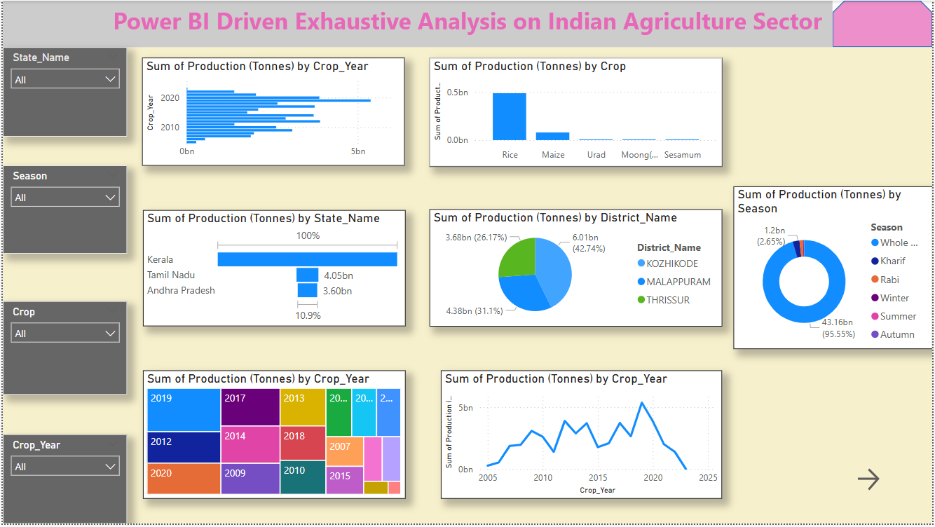
Screenshot of Output:

Slide 8
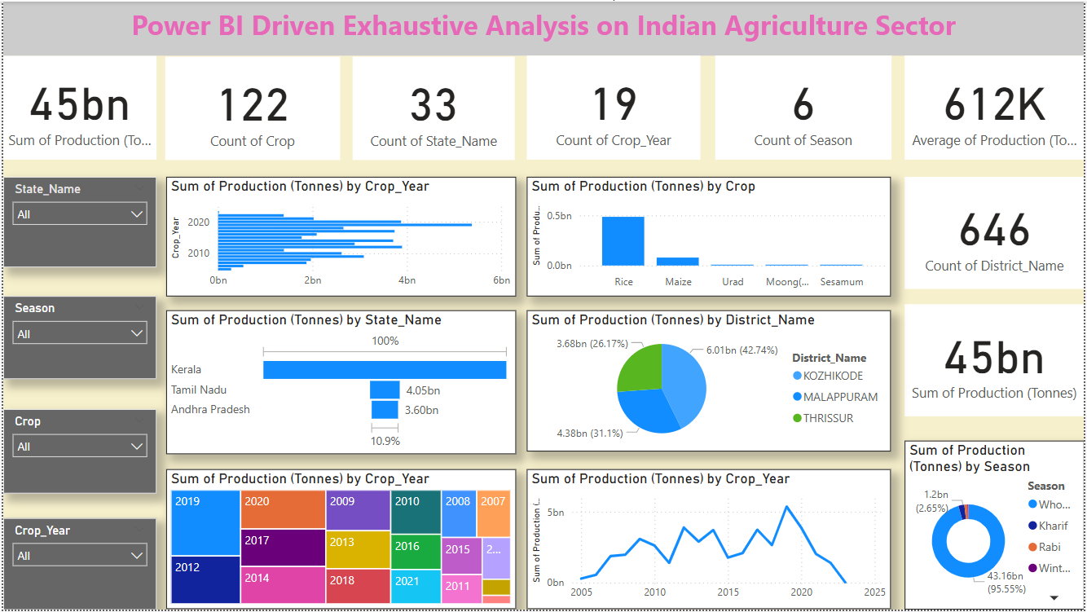
Screenshot of Output:

Slide 9
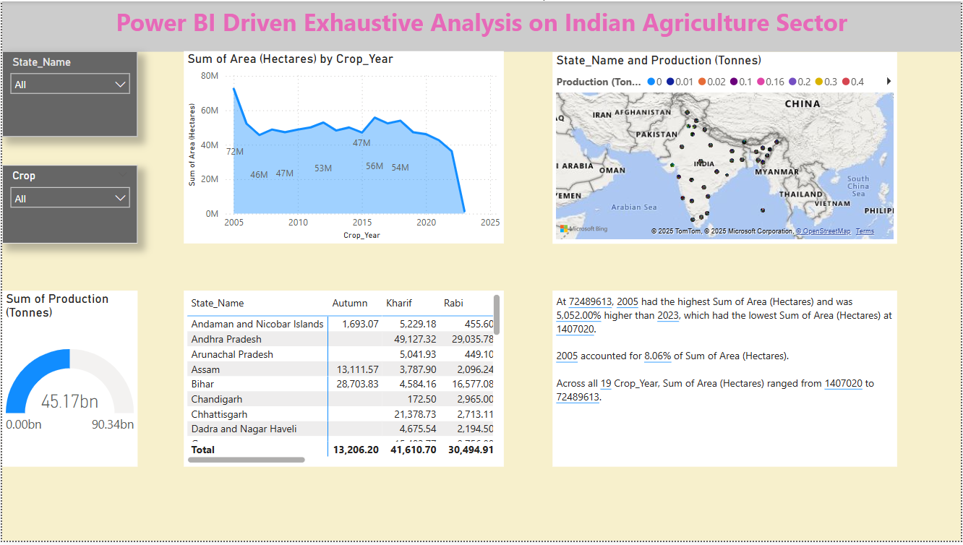
Screenshot of Output:

Slide 10
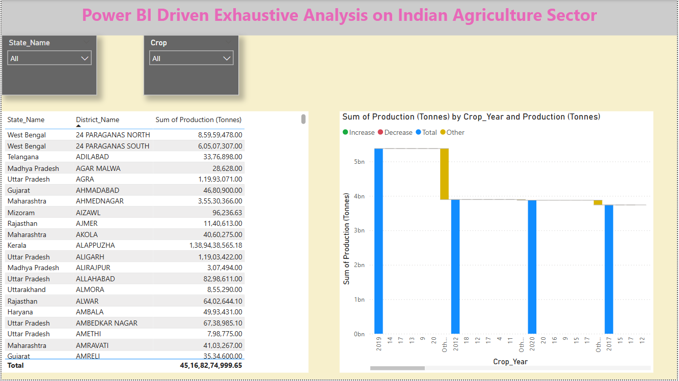
Screenshot of Output:

Slide 11
Conclusion:
The Power BI analysis highlights critical aspects of the Indian agriculture sector, providing actionable insights.
By leveraging data visualization and predictive analytics, stakeholders can improve efficiency and sustainability in agriculture.
Future improvements include integrating real-time data sources and AI-driven recommendations to enhance decision-making further.
This study sets the foundation for using technology to revolutionize the agricultural landscape in India.

